Slide 1
Chapter 1 Introduction to Computer
Network

Slide 2
Introduction
Network is the interconnection of a set of devices capable of communication.
There may be 2 kinds of devices in the network
Host:- also called end system. (desktop, laptop, cell phone)
Connecting Devices:- connects to other devices(modem, router, switch)
Network Criteria
Performance(evaluated by throughput and delay)
Reliability(evaluated by frequency of failure)
Scalability(Adding processing capacity)
Security(protecting data from unauthorized access)

Slide 3
Introduction
Application of Computer Networks
Business Application
Resource Sharing
High Reliability
Saving Money
Home Application
Access to Remote Information(WWW)
Person to Person communication
Interactive Entertainment(Live TV, Games)

Slide 4
Merits
Allows File Sharing/ Resource Sharing
Inexpensive System
Flexible to be Used
Increase in Storage Capacity of the Software

Slide 5
Demerits
Security Difficulties(Hacking)
Presence of Computer Viruses and Other Malwares

Slide 6
Network Models
There are several classification for networks
Classification based on Scale(size)
Classification based on Topology
Classification based on Architecture

Slide 7
Network Models : Based on Scale
According to the scale(size) of the networks is classified into following
LAN (Local Area Network)
MAN (Metropolitan Area Network)
WAN (Wide Area Network)

Slide 8
Local Area Network(LAN)
It is a computer network that spans a relatively small area
Most LANs are confined to a single building or group of buildings
One LAN can be connected to other LANs over any distance via telephone lines and radio waves (WAN)
Medium: optical fibers, coaxial cables, twisted pair, wireless.
Low latency (except in high traffic periods).
High speed networks (0.2 Mb/sec to 1Gb/sec).
Speeds adequate for most distributed systems

Slide 9
Metropolitan Area Network(MAN)
Metropolitan Area Network, are data networks designed for a town In terms of geographic breadth
MANs are larger than local area networks (LANs), but smaller than wide-area networks s)
MANs are usually characterized by very high-speed connections using fiber optical cable or other digital media
Features:
Generally covers towns and cities (50 kms)
Medium: optical fibers, cables.
Data rates adequate for distributed computing applications.

Slide 10
Metropolitan Area Network
MAN is usually not privately owned by an organization (Like banks, MNC)
Access to a MAN is usually trough a network provider who sells the service to the users
MAN often acts as a high speed network to allow sharing of regional resources
It is also frequently used to provide a shared connection to other networks using a link to a WAN

Slide 11
Wide Area Network(WAN)
A computer network that spans a relatively large geographical area
WAN consists of two or more local-area networks (LANs).
Computers connected to a wide-area network are often connected through public networks, such as the telephone system
They can also be connected through leased lines or satellites
The largest WAN in existence is the Internet

Slide 12
Personal Area Network(PAN)
Used for data transmission among devices such as computers, mobile phones, PDA etc.
Within few meters like 10 meters only
Medium : Bluetooth, Infrared
Only very few connections will be available

Slide 13
Campus Area Network(CAN)
Computer network that links the buildings and consists of two or more local area networks (LANs) within the limited geographical area
It can be the college campus, enterprise campus, office buildings, military base, industrial complex
CAN is one of the type of MAN (Metropolitan Area Network) on the area smaller than MAN
The Campus networks usually use the LAN technologies, such as Ethernet, Token Ring, Fibber Distributed Data Interface (FDDI), Fast Ethernet, Gigabit Ethernet, Asynchronous Transfer Mode (ATM)

Slide 14
Country Area Network(CAN*)
It’s wide area network which is limited to country
It consist of more than one MAN
It may be extended up to thousands kms
It is more public network owned by some public organization or governments
Example: In Nepal NTC have CAN*
•

Slide 15
Global Area Network(GAN)
A global area network (GAN) refers to a network composed of different interconnected networks that cover an unlimited geographical area.
The term is loosely synonymous with Internet, which is considered a global area network.

Slide 16
Topology
Topology :- Physical inter connection between different node
Node:- End device in computer network(Laptop, mobile, desktop, PDA, tablet etc.)
Various Topologies are:-
Bus
Ring
Star
Mesh
Tree
Hybrid

Slide 17
Bus
In this system there are 8 nodes connected to network using common connection also called bus
All communication is done with help of bus.
Advantage:
Less expensive
Disadvantage
Only one connection at a time
Figure : Bus Topology
2
1 3
4
Bus
5 6 8
7
Consider if node 1 is communicating with 5 other node have to wait for data transfer till
1-5 finished the communication is completed

Slide 18
Ring
Data travels in circular fashion from one computer to another on the network.
Typically Token Ring technology are used to implement a ring network
Data access based on token
Only one way data transfer
Data passed through intermediate
nodes to destination
1
3
2
4
5
Consider if data transfer from node 1 to 2, It will pass through 3,5,4 and reaches 2

Slide 19
Star
All computers/devices connect to a central device called hub or switch.
Each device requires a single cable
Point-to-point connection between the device and hub.
Most widely implemented
Hub/Switch is the single point of failure
1
4
Hub/Switch
2
3

Slide 20
Mesh
Each computer connects to every other.
High level of redundancy.
Rarely used
Wiring is very complicate
Cabling cost is high
Troubleshooting a failed cable is tricky
N(n-1)/2
1
2
3
4

Slide 21
Tree
Hierarchical structure like inverted tree
Top node (node 1) is the root node
It should at least have 3 levels
Ideal for nodes that are grouped for some specific job
1
Level 1
2
3
Level 2
4
5
6
7
Level 3

Slide 22
Hybrid
Two or more different types of topologies which is a mixture of two or more topologies
For example if in an office in one department ring topology is used and in another star topology is used, connecting these topologies will result in Hybrid Topology (ring topology and star topology).
Advantages
Effective
Scalable
Flexible
Disadvantages
Complex in design
Costly.

Slide 23
Network Models : Based on Architecture
Network architecture refers to how computers are organized in a network and how tasks are allocated between these computers
Two of the most widely used types of network architecture are
Peer-to-Peer(P2P)
Client/Server

Slide 24
Peer to Peer(P2P)
1
2
P2P
Tasks are allocated among all the members of the network
No hierarchy(importance) -- All considered equal
Does not use a central computer server that controls network activity
All computer on the network has a special software running that allows for communications between all the computers
One – One(1:1) relationship
Peer-to-peer is mostly used for file sharing
One of the earliest peer-to-peer file sharing networks was Napster
Now torrent uses this way to share files

Slide 25
Peer to Peer(P2P)
Advantage
Easy to install and configure
All the resources and contents are shared by all the peers
P2P is more reliable as central dependency is eliminated
No need for full-time System Administrator(No central Admin)
Cost comparatively very less

Slide 26
Peer to Peer(P2P)
Disadvantage
One person (user / administrator )cannot determine the whole accessibility setting of whole network
Security in this system is very less viruses, spywares,trojans, etc malwares can easily transmitted over this P-2-P architecture
Data recovery or backup is very difficult. Each computer should have its own back-up system
Lot of movies, music and other copyrighted files are transferred using this type of file transfer. P2P is the technology used in torrents

Slide 27
Client/Server(Tiered)
Computing system in which one powerful workstation serves the requests of other systems
Server :- Provides services to clients
Client :- Accept services from server
Server is central device for managing files , and other resources.
If server is down all communication among the clients will be down
Features of Servers :-
They have large storage capacity.
They are able to provide information to many computers simultaneously,
therefore have large RAM
Its processor speed is high, as it may have to execute multi-tasking too

Slide 28
Client/Server
Advantages
Server
Centralization
Proper Management
Back-up and Recovery possible
Upgradation and Scalability in Client-server set-up
Accessibility
Security
C1
C2
C3
Clients

Slide 29
Client/Server
Disadvantages
Congestion in Network(Too many requests at same time)
Cost : It is very expensive to install and manage this type of computing
Client-Server architecture is not as robust as a P2P and if the server fails, the whole network goes down.
You need professional IT people to maintain the servers and other technical details of network.

Slide 30
Internet, Intranet & Extranet
Internet:- Connections between different network/LAN. There will be outside connection. It is public network
Intranet:- Connection inside a network/LAN. No outside connection
Extranet:- Connects 2 or more intranet but not private. It is used to connect between 2 branches of company or connection between company and client.

Slide 31
Reference Model
2 important reference models OSI reference model & TCP/IP reference model
Also called Protocol Architecture or Layered Architecture
Mainly define the protocols of communication in layered architecture

Slide 32
Protocol ???
Protocol means rule
In computer networking Protocol means rules for establishing communication between 2 devices
Consists of a set of rules that govern data communications
determines what is communicated, how it is communicated and when it is communicated
Key Elements
Syntax
Semantics
Timing

Slide 33
Syntax, Semantics and Timing
Syntax
Structure or format of the data
Indicates how to read the bits - field delineation
Syntax should be same in sender and receiver for to communicate
Semantics
Interprets the meaning of the bits
Knows which fields define what action
Interpretation of the syntax should be same
Timing
When data should be sent and what
Speed at which data should be sent or speed at which it is being received

Slide 34
ISO/OSI Reference Model
ISO- International Organisations for Standard
OSI- Opens System Interconnections
Stats developing in late 1970s
Approved by 1984
The term “Open” in Open System Interconnections denotes “to communicate with any 2 systems”
There are 7 layers in OSI Reference model
It is also called OSI layered architecture /OSI Protocol architecture

Slide 35
ISO/OSI Reference Model
The process of breaking up the functions or tasks of networking into layers reduces complexity.
Each layer provides a service to the layer above it in the protocol specification.
Each layer communicates with the same layer’s software or hardware on other computers.
The lower 4 layers are concerned with the flow of data from end to end through the network
The upper Three layers of the OSI model are orientated more toward services to the applications

Slide 36
ISO/OSI Reference Model- 7 Layers
Layer 7 –Application Layer
Layer 6 –Presentation Layer
Layer 5 –Session Layer
Layer 4 –Transport Layer
Layer 3 –Network Layer
Layer 2 –Data Link Layer
Layer 1 –Physical Layer
Please do not throw sausage pizza Away

Slide 37
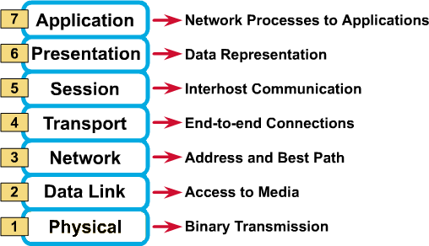
ISO/OSI Reference Model- 7 Layers

Slide 38
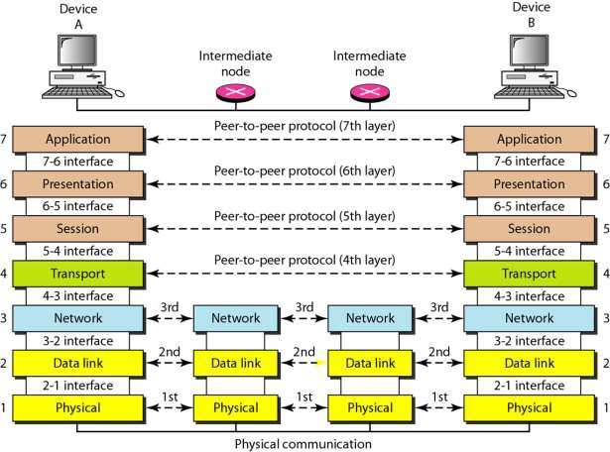
ISO/OSI Reference Model- 7 Layers

Slide 39
Application Layer (Layer 7)
The application layer is responsible for providing services to the user
The layer relates to the services that directly support user applications, such as software for file transfers, database access, and e-mail, web browsers
A message to be sent across the network enters and exits the OSI reference model's a at this layer.
Protocols works in this layer are HTTP,FTP,DNS..
HTTP(HyperText Transfer Protocol)
FTP(File Transfer Protocol)
DNS(Domain Name System)

Slide 40
Presentation Layer (Layer 6)
Defines the format used to exchange data among networked computers
Acts like translator (interpreter)
When computers from dissimilar systems—such as IBM, Apple, and Sun—need to communicate, a certain amount of translation and byte reordering must be done
Within the sending computer, the presentation layer translates data from the format sent down from the application layer into a commonly recognized, intermediary format

Slide 41
Presentation Layer (Layer 6)
At the receiving computer, this layer translates the intermediary format into a format that can be useful to that computer's application layer
The presentation layer is responsible for converting protocols, translating the data, encrypting the data, changing or converting the character set, and expanding graphics commands.
The presentation layer also manages data compression to reduce the number of bits that need to be transmitted.

Slide 42
Session Layer (Layer 5)
Session is a logical connection between 2 systems
Layer is responsible creating managing and termination of session
Also responsible for dialogue management
3 Types of Dialogue
Simplex : 1 Way Communication(Radio)
Half Duplex : 2 Way Communication, But One at a time (Walkie-Talkie)
Full Duplex: 2 Way Simultaneous Communication (Telephone)
Also Provide Security and Check points in data

Slide 43
Transport Layer (Layer 4)
Provide a reliable mechanism for the exchange of data between two processes in different computers.
Data from above layer is converted into smaller Data Units called segments
Segments consist of Port number , Acknowledge number, Sequence number

Slide 44
Transport Layer (Layer 4)
Ensures that the data units are delivered error free, delivered in sequence, there is no loss or duplication of data units.
Provides connectionless(UDP) or connection oriented service(TCP).
Provides for the connection management.
Multiplex multiple connection over a single channel.

Slide 45
Transport Layer (Layer 4) TCP vs UDP
TCP( Transmission Control Protocol )
Connection Oriented
Reliable
Have Acknowledgement
Have Retransmission
Have Sequence Delivery
Have Handshaking
UDP ( User Datagram Protocol )
Connectionless
Unreliable
No Acknowledgement
No Retransmission
No Sequence delivery
No Handshake signal

Slide 46
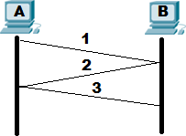
Transport Layer (Layer 4) - 2 Way Handshaking
3 way handshaking signal establish logical connection between 2 computers before data transfer
Steps involved are:-
TCP Connection Request(Syn A
to B)
TCP Connection Reply(Ack B to A)
Data Transfer (A to B)

Slide 47
Network Layer (Layer 3)
Data units from the Transport layer is converted into packets(IP Packets)
Each packet consist of IP Header
IP header consist of Source IP, Destination IP and several other details regarding Packet
IP(Internet Protocol) address helps packet to navigate from source to destination between different network(internetwork)
Implements routing of packets through the network

Slide 48
Network Layer (Layer 3)
Defines the most optimum path the packet should take from the source to the destination
Handles congestion in the network.
Facilitates interconnection between heterogeneous networks (Internetworking).
The network layer also defines how to fragment a packet into smaller packets to accommodate different media
Protocol in this layer is IP(Internet Protocol)

Slide 49
Data Link Layer (Layer 2)
Packet from network layer is converted to Frames
Frame consist of frame header
Frame header consist of source and destination MAC(Media Access Control) Address
Data link layer attempts to provide reliable communication over the physical layer interface
Create and detect frame boundaries
Implement flow control, Error control(Parity, Hamming Code)
Supports points-to-point(unicasting) as well as broadcast communication
Supports simplex, half-duplex or full-duplex communication

Slide 50
Physical Layer (Layer 1)
Convert the frames into bits (0/1) and transmit through medium
Provides physical interface for transmission of information
Defines rules by which bits are passed from one system to another
Covers all - mechanical, electrical, functional and procedural - aspects for physical communication.
Such characteristics as voltage levels, timing of voltage changes, physical data rates, maximum transmission distances, physical connectors, and other similar attributes are defined by physical layer specifications.

Slide 51
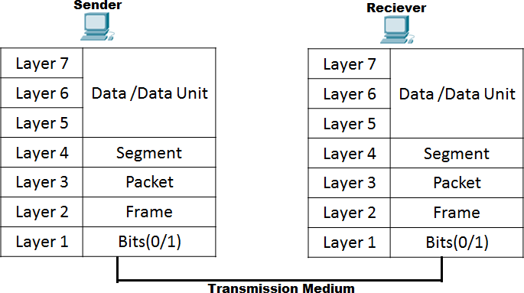
OSI Layer Working

Slide 52
TCP/IP Reference Model
Also called Internet Reference model
Consist of 4 layered Architecture
Application Layer
Transport Layer
Internetwork Layer(Internet Layer)
Network Access Layer (Network Interface Layer)

Slide 53
TCP Layer
Application Layer
Similar to Application Presentation and Session layer in OSI
Application programs using the network
Transport Layer (TCP/UDP)
Similar to Transport Layer in OSI
Only TCP protocol works
Management of end-to-end message transmission,
error detection and error correction

Slide 54
TCP Layer
Internetwork Layer (IP)
Similar to Network layer in OSI
IP Address
Handling of packets : routing and congestion
Network Access Layer
Similar to Datalink and physical layer in OSI
Management of cost effective and reliable data delivery,
access to physical networks
Physical Media

Slide 55
TCP/IP vs OSI
Application | Data | Application | Data
Presentation
Session
Transport | Segment | Transport | Segment
Network | Packet | Internetwork | Packet
Data Link | Frames | Network Access | Frames & Bits
Physical | Bits
OSI |  | TCP/IP

Slide 56
TCP/IP Vs OSI
OSI
7 Layered architecture
Designed for General Network
Supports TCP and UDP
Designed both Functionalities of layer and protocol
Defines functionalities of all layer
Protocols are hidden in OSI model and are easily replaced as the technology changes.
TCP/IP
4 Layered architecture
Internet only
Supports only TCP
More based on protocols than functions
Only protocol
Difficult to change the protocol in future

Slide 57
Connection-Oriented Services
There is a sequence of operations to be followed by the users of connection-oriented service. These are:
The connection is established.
Information is sent.
The connection is released.
In connection-oriented service, we have to establish a connection before starting the communication. When the connection is established, we send the message or the information and then we release the connection.
Connection-oriented service is more reliable than connectionless service. We can send the message in a connection-oriented service if there is an error at the receiver's end. An example of connection-oriented is TCP (Transmission Control Protocol) protocol.

Slide 58
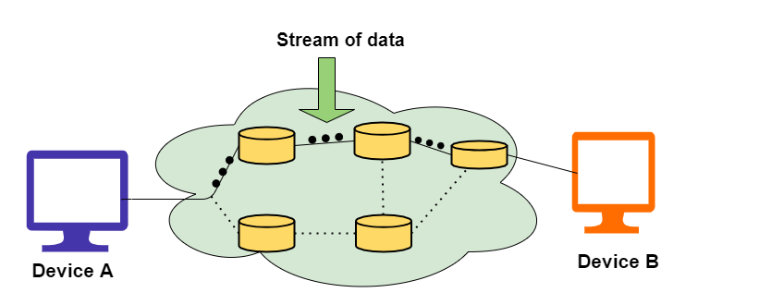

Slide 59
Connection Less Services
It is similar to the postal services, as it carries the full address where the message (letter) is to be carried. Each message is routed independently from source to destination. The order of messages sent can be different from the order received.
In connectionless the data is transferred in one direction from source to destination without checking the destination is still there or not or if it prepared to accept the message. Authentication is not needed in this. An example of a Connectionless service is UDP (User Datagram Protocol) protocol.

Slide 60
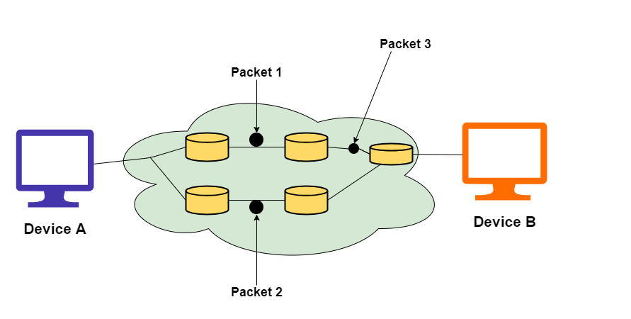

Slide 61
Connection-Oriented Services | Connection Less Services
Connection-Oriented services are designed on the basis of the Telephone System. | Connectionless services are based on the Postal System.
In this type of service, a prior connection needs to be established. | In this type of service, no prior connection is needed.
These services Ensure the reliable transfer of data. | As these services are best efforts services but reliability is not guaranteed in these.
There is no possibility of congestion. | There are chances of occurrence of congestion using these services.
In this authentication is required before transmitting the data packets to the receiver. | In this, authentication is not required before transmitting the data packets to the receiver.
These services are suitable for long and steady transmissions. | These services are suitable for bursty transmissions.
In this connection is established through the process of signaling | There is no such signaling concept exists.
In this type of service, data packets travel towards their destination node in a sequential manner. | In this type of service, data packets travel towards their destination node in a random manner.
Retransmission of lost data bits is possible. | In this, it is not possible.
Delay is more while transferring the information. But after the establishment of connection, these services offer fast delivery of information. | Due to the absence of the connection establishment phase, there is no delay.

Slide 62
Internet service provider (ISP)
An internet service provider (ISP) is a company that provides access to the internet. ISPs can provide this access through multiple means, including dial-up, DSL, cable, wireless and fiber-optic connections.
A variety of companies serve as ISPs, including cable providers, mobile carriers, and telephone companies. In some cases, a single company may offer multiple types of service (e.g., cable and wireless), while in other cases, a company may focus on just one type of service (e.g., fiber-optic). Without an ISP, individuals and businesses could not reach the internet and the opportunities it provides.

Slide 63
Internet
Internet is defined as an Information super Highway, to access information over the web. However, It can be defined in many ways as follows:
Internet is a world-wide global system of interconnected computer networks.
Internet uses the standard Internet Protocol (TCP/IP).
Every computer in internet is identified by a unique IP address.
IP Address is a unique set of numbers (such as 110.22.33.114) which identifies a computer location.
A special computer DNS (Domain Name Server) is used to give name to the IP Address so that user can locate a computer by a name.
For example, a DNS server will resolve a name http://www.google.com to a particular IP address to uniquely identify the computer on which this website is hosted.
Internet is accessible to every user all over the world.

Slide 64
Backbone Network
A backbone or core network is a part of a computer network which interconnects networks, providing a path for the exchange of information between different LANs or subnetworks.
A backbone can tie together diverse networks in the same building, in different buildings in a campus environment, or over wide areas. Normally, the backbone's capacity is greater than the networks connected to it.
A large corporation that has many locations may have a backbone network that ties all of the locations together, for example, if a server cluster needs to be accessed by different departments of a company that are located at different geographical locations.
The pieces of the network connections (for example: Ethernet, wireless) that bring these departments together is often mentioned as network backbone.

